Slide 1
CS 4530: Fundamentals of Software Engineering Module 1.2: Requirements and User Stories
Adeel Bhutta, Joydeep Mitra and Mitch Wand
Khoury College of Computer Sciences
© 2025 Released under the CC BY-SA license

Slide 2
Learning Goals for this Lesson
At the end of this lesson, you should be able to
explain the overall purposes of requirements analysis.
enumerate and explain 3 major dimensions of risk in Requirements Analysis.
document requirements user stories.
track the completion of requirements using conditions of satisfaction.
explain the difference between functional and non-functional requirements.
Explain how Value Sensitive Design can be used to improve requirement gathering.

Slide 3
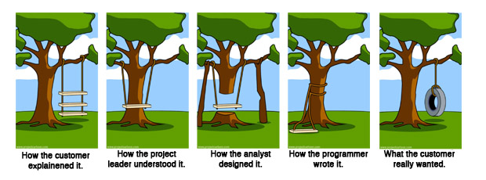
Overall question: How to make sure we are building the right thing
Requirements Analysis
Planning & Design
Implementation
Notes:
The overall question for Requirements Gathering is making sure that we are building the right thing.
This meme does a great job capturing the many ways in which we can get off course and end up building the wrong thing.

Slide 4
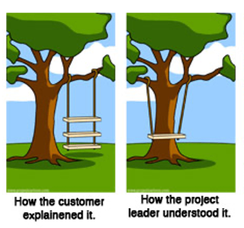
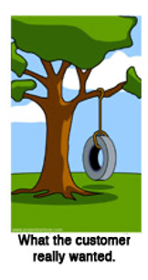
Why is requirements analysis hard?
Problems of understanding
Do users know what they want?
Do users know what we don’t know?
Do we know who are users even are?
Problems of scope
What are we building?
What non-functional quality attributes are included?
Problems of volatility
Changing requirements over time
4
Notes:
Consider right now an example developing of a virtual meeting platform. With the start of the COVID-19 pandemic, and shift to virtual meetings, there has been an enormous demand for software to help substitute for physical events. But, even today, many platforms still don’t provide the experience that users want: how do you replace some physical interactions with a software product? These kind of challenges come up all of the time in software projects.
Sometimes, clients want to bring software in to solve some problem that is currently not being addressed, but don’t know exactly how to solve it. In other times, new software is brought in as a technology to improve an existing process. There is a way that things are done, and your software is going to help that get done better. In those situations, the client may simply not know what will work best for them.
Software engineering aims to provide answers, or at least a framework for answers to these questions
<Read slide. Possible elaboration:>
Examples of problems of understanding corresponding to the bullets:
What they want? -> Simply don’t know what is possible, won’t know it until they see it, often know what the problem is that they want the software to solve, but not the solution. Coming up with the solution is a design problem. Good to have a buddy who is a user experience designer.
What we don’t know? -> Most software is not “general purpose”, but exists within some domain.
Who are our users? -> Maybe most common in startups, where you have a client (moneybags investors) who are guessing who your users will be and what they want
Scope - What are we building? -> How to agree with client on a statement of work that is feasible given constraints, how to make sure that we stay on track?
Scope – quality attributes -> How to specify things like performance, usability, maintainability, security, etc
Volatility -> Long projects are subject to changes in world around them

Slide 5
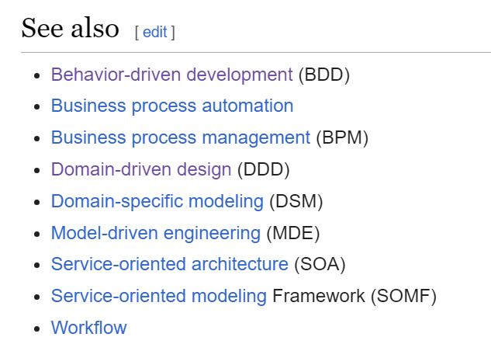
How do we capture the requirements?
There are many methodologies for this.
Often described as x-Driven Design (for some x)
They differ in scope & details, but they have many features in common.
Notes:
In this lesson, we'll primarily be concerned with problems of understanding. How do we get from a customer's vague notions of what they might want to something concrete enough to guide us to build it.
<read slide>

Slide 6
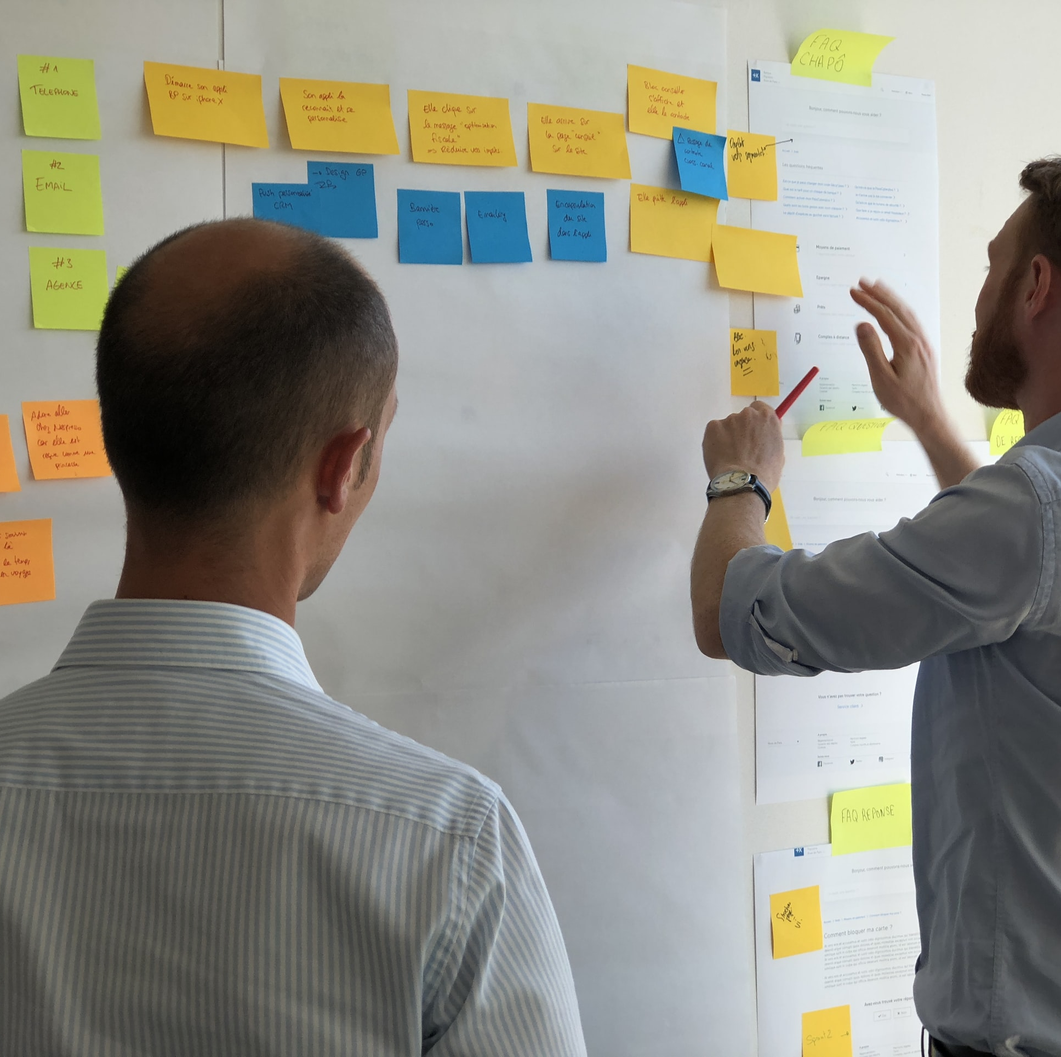
Common Elements
Meet with stakeholders
Develop a common language
Collect desired system behaviors that offer value
Document the desired behaviors
Iterate and refine!!
Notes:
Here are some things that these different methods have in common. Notice two important things: stakeholders and value <read slide>

Slide 7
Different Methodologies Produce Different Forms of documentation
TDD: executable tests
BDD: "scenarios"
DDD: an OO architecture
Notes:
In "test-driven design", the desired behaviors are typically documented as sets of tests.
In "behavior-driven design", the desired behaviors are documented as "scenarios"-- descriptions of behaviors that are intended to be understandable by both customers and developers.
In "domain-driven design", the primary deliverable is a system architecture that describes the interactions between the different portions of the system.

Slide 8

We'll use a least-common-denominator approach: user stories
Notes:
In this course, we'll try to document our requirements as "user stories". Something like user stories show up in all these methods.

Slide 9

User Stories document requirements from a user’s point of view
As a <role> I want
<some capability>
so that I can <get some benefit>
User stories specify what should happen, for whom, and why
Notes:
User stories concentrate on the user and their interaction with the new system.
A user story is a short simple description of ONE feature that can fit on a 3x5” card, written in the user’s language.
<read slide>
User stories describe the capabilities that your software should provide. How do we expect users to actually interact with our system, and what results should they see?
They do NOT directly describe the full behaviors of those capabilities. For example: Under what circumstances should this capability be provided? What should happen if it can’t be provided? These are details that will eventually need to be spelled out, but right now we want a bird's-eye view of the desired capabilities.
These are not called “customer” stories, they are “user stories”. You might develop software for a self-driving car, and your customer is Tesla. But your user is Tesla’s customer. User stories force both you and your customer to focus on your user, who is presumably the one who wants to extract value from your software
“Role” lets us distinguish between the different ways that our software might be used: Canvas is used by both instructors and students. However, there are even more roles, which have different capabilities: TAs can also view grades, but they can’t add new Tas. “Course observers” can see course content, but not grades, and are not enrolled in the class. There are quite a few different roles in Canvas, and maybe you can see how it would help to organize features in that way.
Why do we include the value? Because ultimately our goal with building software is presumably to deliver value – do something that helps some user accomplish some goal. That “something of value” is really what the requirement is. The customer probably doesn’t care to define every possible output for their system for every possible input – instead they just want to tell you what they want to have happen, in language that is as close to their own as possible.
What makes a good user story?

Slide 10
Properties of a user story
short: fits on a 3x5 card
may have prerequisites
has conditions of satisfaction that expand on the details
has a priority
satisfies the INVEST criteria (more on this later)

Slide 11
Examples:
As an online blackjack player, I want a game of blackjack implemented so that I can play blackjack with other users. (Essential)
As a citizen, I want to be able to report potholes so that the town can do something about them. (Essential)
As a College Administrator, I want a database to keep track of students, the courses they have taken, and the grades they received in those courses, so that I can advise them on their studies. (Essential)

Slide 12

Conditions of Satisfaction fill in details of the desired behavior
Each condition of satisfaction
Describes a testable behavior, from the user's point of view
Must have a priority
Should be numbered within its user story
Notes:
Conditions of satisfaction are, effectively, test cases – or templates for test cases. These kinds of tests are sometimes called “acceptance tests” because they constitute the end-user accepting that your software does what they want.

Slide 13
Examples
1.1 There should be an accessible blackjack table (Essential)
1.2 A user can initiate a game of blackjack (Essential)
- 1.3 Users can enter a blackjack table as a player if no other player is currently occupying the slot (Essential)
- 1.4 Players can successfully hit (take a card) each turn (Essential)
- 1.5 Players can successfully stand (refrain from taking a card) each turn (Essential)
- 1.6 Players successfully win if the dealer goes above 21 before me (Essential)

Slide 14
Priorities
Essential means the project is useless without it.
Desirable means the project is less usable without it, but is still usable.
Extension describes a user story or COS that is may not be achievable within the scope of the project. These might be things you'd want "in the next version".
Notes:
User stories and COSs must be prioritized as Essential, Desirable or Extension.

Slide 15
Minimum Viable Product
The set of essential user stories constitutes the minimum viable product (MVP)
A user story is "implemented " when all its essential COSs are implemented.
Caution: when proposing a project, don't make your MVP too hard to complete (but don't make it too easy, either)
Notes:
The set of essential user stories constitutes the minimum viable product.
[Note: on the project you get 100 points for delivering your MVP (all
essential user stories and their essential COSs) + up to 50 additional points for delivering
extra stories, so be careful about what you call "essential". OTOH,
we will ask you to extend any project proposal that is too conservative.]

Slide 16
The MVP and Your Project Grade
On your project, you will get 200 points (out of a total of 400) for code submission:
MVP (all essential user stories and their essential COSs delivered): 100 points
Extra features (desirable and/or optional features): 50 points
Testing: 50 points
SO: be realistic about what you call "essential" ☺
Notes:
Here are a few more details about what that means in the context of your project.

Slide 17
There are several frameworks that help us in requirement gathering
One framework recommends paying special attention to stakeholders and human values when writing user stories
It allows us to reason about design choices and resolve tensions between different values
Considering human values in the design process is considered a responsible approach. Some call it ethical
Its official name is Value Sensitive Design (VSD)
Notes:
The process of VSD includes three kinds of investigations:
understanding context (how human value works in real life) – Empirical Investigation
identifying stakeholders, thinking about their goals and values and then finally resolving the value tensions arising from conflicting interests of stakeholders – Value Investigation
The technical feasibility of implementing the solutions – Technical Investigation
You will learn more about this in tutorial that you will review as part of the activity.

Slide 18
Example: Informed Consent in Stack Overflow
Stakeholders identified:
Site users
Site owners
Values identified:
Privacy
Accountability
Transparency
User Story Examples:
As a Stack Overflow user, I want to clearly understand what personal data Stack Overflow collects through cookies and control which cookies are set so that I can make an informed choice about my privacy while still accessing the programming help I need. (Essential)
As a Stack Overflow site owner, I want to implement transparent cookie consent processes that comply with regulations while maintaining user engagement so that I can build user trust, avoid legal penalties, and sustain my business model without losing essential functionality. (Essential)
Notes:
<Read slide>

Slide 19
Example: Informed Consent in Stack Overflow
User Story and COS:
As a Stack Overflow user, I want to clearly understand what personal data Stack Overflow collects through cookies and control which cookies are set so that I can make an informed choice about my privacy while still accessing the programming help I need. (Essential)
The system should display a clear cookie banner explaining what personal data is collected before any cookies are set (Essential)
Users should be able to access granular cookie controls to accept/reject specific categories (functional, analytics, advertising, personalization) (Desirable)
The system should provide a “privacy dashboard” showing what data has been collected about the user over time (Extension)
User Story and COS:
As a Stack Overflow site owner, I want to implement transparent cookie consent processes that comply with regulations while maintaining user engagement so that I can build user trust, avoid legal penalties, and sustain my business model without losing essential functionality. (Essential)
Cookie data containing personal information should be encrypted both in transit and at rest to prevent unauthorized access. (Essential)
The system should automatically expire cookies based on predefined retention periods. (Essential)
The system should allow users to read and search posts even if they reject data collection on cookies. (Desirable)
The platform should implement automated data retention policies that permanently delete expired cookie data. (Extension)
Notes:
<read slide>

Slide 20
Ethical design will consider impact of your choices
You should consider how your software can cause harm or may be used to do wrong. Examples:
A dictator who wants to suppress information so he can continue to oppress minorities
the site owner who wants to harvest user information for resale
As part of VSD, you should write user stories and conditions of satisfaction that minimize negative human impact
Notes:
<read slide>

Slide 21
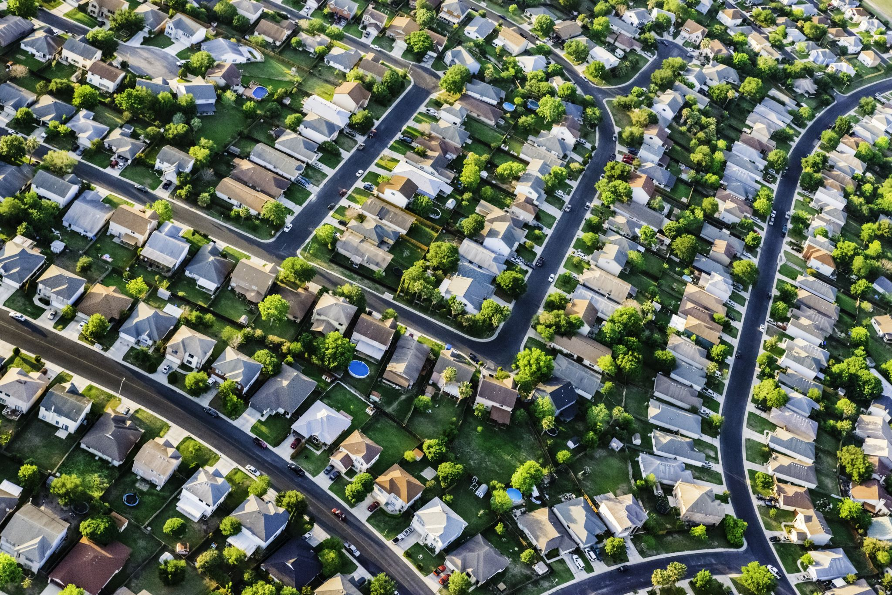
Another Example: a Pothole reporting system
A town wants a system where citizens can a report potholes and the town can monitor progress on repairing them.

Slide 22
User Story #1
As a citizen, I want to be able to report potholes so that the town can do something about them. (E)

Slide 23
Conditions of Satisfaction
1.1 I should be able to report a pothole to the system (E)
1.2 I should be able to see whether the pothole I report has been repaired (E)
1.3 I should be able to see whether someone else has already reported a given pothole (D)
1.4 I should be able to see an estimated time when the pothole should be repaired (D)

Slide 24
User Story #2
As a repair-truck driver, I want the system to display the potholes I should be working on today. (E)

Slide 25
Conditions of Satisfaction
2.1 I should be able to see my list of potholes for today (E)
2.2 I should be able to report that I repaired a given pothole (E)
2.3 I should be able to report that I was unable to repair a given pothole, and to supply a reason (E)
2.4 My daily list of potholes should be listed in an order that cuts down the time I spend driving from job to job (D)

Slide 26
User Story #3
As a maintenance supervisor, I want to be able to control the order in which potholes are repaired (D?)
Notes:
Maybe this is desirable, maybe it's essential.

Slide 27
Conditions of Satisfaction
3.1 I should be able to give a higher priority to potholes on a particular street (E)
3.2 I should be able to give a higher priority potholes in a particular neighborhood (E)
3.3 I should be able to see on a map where there are a lot of potholes (D)
3.4 I should be able to see on a map which potholes that have been reported multiple times (D)

Slide 28

Yet another example: a University Transcript database

Slide 29

User Story
As a College Administrator, I want a database to keep track of students, the courses they have taken, and the grades they received in those courses, so that I can advise them on their studies.

Slide 30
Satisfaction Conditions
The database should allow me to:
Add a new student to the database
Add a new student with the same name as an existing student.
Retrieve the transcript for a student
Delete a student from the database
Add a new grade for an existing student
Find out the grade that a student got in a course that they took
Notes:
What do you think of these COSs? Are they all essential? Can you think of any satisfaction conditions that might be desirable, but not essential? What conditions might you want "in the next version" (those would be extensions).

Slide 31
Non-Functional Requirements capture the quality goals of the system:
As developers, we often spend most of our time and effort on features (i.e., functional requirements).
But there is more ….
What other properties might a customer want to know about the product?
How quickly can a transcript be retrieval? (Performance)
How many student transcripts can our system store? (Scalability)
How long did I spend on the phone with support to set up the software? (Usability)
After my system is setup, is the access controlled at all? (Security)
Are these any times when I can’t use this system? (Availability)
Notes:
What we've talked about so far are called "functional requirements"-- the minimum functions that a system must be able to perform.
But there are other kinds of requirements. These are called "non-functional" requirements.
Non-functional requirements capture the quality goals of a system.
Here are some obvious ones <read slide>

Slide 32
Example:
“With a 4-core server and 16 GB RAM, the system should be able to service at least 200 simultaneous clients with less than 300ms latency”
Notes:
For example, one high-level goal is to say “I want performance”. But what does performance mean? You probably mean to say that you expect that the system has some particular capacity (in terms of simultaneous users), who can simultaneously have their requests satisfied within some response time. That’s still not the whole picture though, because you didn’t specify the efficiency of your system: what hardware resources does it use to achieve that performance?

Slide 33
Other non-functional requirements
Accessibility
Availability
Capacity
Efficiency
Performance
Privacy
Response Time
Security
Supportability
Usability
Notes:
Here are some other categories of non-functional requirements.

Slide 34
Still more non-functional requirements
Qualities that reflect the evolution of the system
Testability
Maintainability
Extensibility
Scalability
Notes:
Non-functional requirements might also impact the static existence of the system, or its evolution.
For example, if a customer intends for your software to be particularly long-lasting, and to be able to be extended – this needs to be said. Similarly, if there are specific testing requirements that your customer needs to comply with, there may be testability requirements, that define the effort needed to test the behaviors of that system.

Slide 35
Writing User Stories: INVEST+R
Independent
Negotiable
Valuable (has value to client)
Estimable (able to estimate development effort)
Small
Testable
Respect for human values
As a <role> I want <capability> so that I can <get some benefit>
Notes:
INVEST is a popular mnemonic for describing what makes a good user story
Independent – Stories should not be coupled between each other, except where obviously necessary. Want to make it so that a user can examine a story on its own
Negotiable – Best stories are result of a negotiation between a client and a developer – how do we come to some mutual agreement about what we are going to build, and why? Goal is to develop what the customer needs
Valuable – Each story should have some benefit that the client can recognize. Value might include value to your business, not just value to the user.
Estimable (that is, estimatable) – As we will see in a bit, being able to estimate how long it will take to implement a user story is key to determining a reasonable scope for your project
Small – In the real world, a rule of thumb is to average 3-4 days of work per story for a full-time developer. For our projects, it might be something a single student might be able to accomplish in a week, along with their other obligations as a student.
Testable – There must be some way to judge completion: for the person implementing the software, and for the end-user.
https://agileforall.com/new-to-agile-invest-in-good-user-stories/
… Let’s see an example and work through some of the tricky bits

Slide 36
Learning Goals for this Lesson
At the end of this lesson, you should be able to
explain the overall purposes of requirements analysis.
enumerate and explain 3 major dimensions of risk in Requirements Analysis.
document requirements user stories.
track the completion of requirements using conditions of satisfaction.
explain the difference between functional and non-functional requirements.
Explain how Value Sensitive Design can be used to improve requirement gathering.

Slide 37
Value Sensitive Design (VSD) is an ethical Framework to gather requirements
Until now we have learned about the methods to document requirements – user stories and conditions of satisfaction.
But how do we come up with requirements in the first place?
One approach is to use an ethical framework called Value Sensitive Design (VSD) to systematically help us reason about the several design choices that go into coming up with requirements.
But, why VSD?
Design choices made during developing software (or any technology) often implicate human values!
Ignoring values in the requirements and design process is irresponsible.

Slide 38
Value Sensitive Design (VSD) in Brief
VSD is a(n) . . .
Outlook for seeing the values in technology design
Process for making value-based choices within design
Combines empirical, value, and technical investigations
Design solutions that incorporate the values held by stakeholders
Considers problems and solutions from diverse perspectives
VSD is not . . .
A moral framework or system of ethics
It does not prescribe decisions to make
It incorporates values reflections in the choosing process
It is not an algorithm for making decisions
Often, there are no easy answers
Takes sustained commitment
Notes:
Emphasize that VSD is a framework to help reason about value-based choices. It is not a prescription of ethics.
The process of VSD includes three kinds of investigations:
Empirical: This is about understanding how the value works in real life based on observations made in the field or from life experiences.
Value: Involves identifying stakeholders, thinking about their goals and values and then finally resolving the value tensions arising from conflicting interests of stakeholders.
Technical: The technical feasibility of implementing the solutions.

Slide 39
Motivating Example – Informed Consent
Empirical Investigation:
Understand what we mean by informed consent, encompasses:
Disclosure. Do we know the pros and cons of taking an action?
Comprehension. Do we understand the disclosures?
Voluntariness. Is there coercion or manipulation?
Agreement. Is there a clear opportunity to consent or not?
Competence. Are we capable to give consent?
Values Investigation:
Who are the direct and indirect stakeholders?
Do the stakeholders have conflicting values?
How can we resolve them?
Technical Investigation:
What are the technical mechanisms for implementing informed consent.
One way => cookie consent management system.
Websites use them to obtain and manage user permission for using cookies.
Notes:
The slide illustrates how to use VSD to think about a value like informed consent:
Do an empirical investigation which involves understanding the meaning of the value. In this case understanding informed consent hinges on four concepts as outlined. Often to understand a value one will have to collaborate with experts in a field such as sociologists, philosophers, domain experts.
Identify the stakeholders and value tensions. For e.g., the stakeholders here could be site users and site owners. Their interests may align or conflict. For e.g., site users may want to be anonymous, but site owners might want to monetize site usage by sharing personal usage data with advertisers. On the other hand they may align if the site owners want to make accountability and transparently a core value of their operations.
Cookies in browsers are one way to collect personal information after taking permission from the users.

Slide 40
Integrating User Stories With VSD
Stakeholders identified:
Site users
Site owners
Values identified:
Privacy
Accountability
Transparency
User Story Examples:
As a Stack Overflow user, I want to clearly understand what personal data Stack Overflow collects through cookies and control which cookies are set so that I can make an informed choice about my privacy while still accessing the programming help I need. (Essential)
As a Stack Overflow site owner, I want to implement transparent cookie consent processes that comply with regulations while maintaining user engagement so that I can build user trust, avoid legal penalties, and sustain my business model without losing essential functionality. (Essential)

Slide 41
Conditions of Satisfaction (Informed Consent)
User Story and COS:
As a Stack Overflow user, I want to clearly understand what personal data Stack Overflow collects through cookies and control which cookies are set so that I can make an informed choice about my privacy while still accessing the programming help I need. (Essential)
The system should display a clear cookie banner explaining what personal data is collected before any cookies are set (Essential)
Users should be able to access granular cookie controls to accept/reject specific categories (functional, analytics, advertising, personalization) (Desirable)
The system should provide a “privacy dashboard” showing what data has been collected about the user over time (Extension)
User Story and COS:
As a Stack Overflow site owner, I want to implement transparent cookie consent processes that comply with regulations while maintaining user engagement so that I can build user trust, avoid legal penalties, and sustain my business model without losing essential functionality. (Essential)
Cookie data containing personal information should be encrypted both in transit and at rest to prevent unauthorized access. (Essential)
The system should automatically expire cookies based on predefined retention periods. (Essential)
The system should allow users to read and search posts even if they reject data collection on cookies. (Desirable)
The platform should implement automated data retention policies that permanently delete expired cookie data. (Extension)

Slide 42
Motivating Example – Informed Consent
Design choices made during developing software (or any technology) often implicate human values!
Ignoring values in the requirements and design process is irresponsible.
A Human Value Example: Informed Consent
Most websites collect vast amounts of information about users, who have no control over: what information is collected/accessed/used/sold/etc.
A VSD approach to informed consent would emphasizes transparency, user control and understanding.
Web cookies and browser security mechanisms represent solutions to implement the principle of informed consent.
To consider human values during design, we need to understand what they means generally and in the specific context of technology
Notes:
It is essential to consider ethics and values when building technology. Ethics is a branch in Philosophy that explores the moral principles and values that guide human behavior and decision making. There is a growing consensus in CS disciplines such as HCI and software engineering to borrow concepts from ethics to help drive design and implementation of software systems.
Identifying and grappling with value tensions during the requirements and design phase leads to “better” apps, websites, software systems, artificial intelligence, etc.
Let’s consider a common example: informed consent
{Optional} Ask students What is Informed consent and how can it be designed in an online environment?
Cookies and security solutions such as HTTPS are an outcome of an analysis that considers ethical aspects and values such as informed consent
The design hinges on the following constructs:
Disclosure refers to providing accurate information on the pros and cons of the action
comprehension refers to a user’s accurate interpretation of what is being disclosed
Voluntariness refers to ensuring no coercion or control
competence refers to an individual’s mental and physical capability to give consent
Agreement refers to a clear opportunity to accept or decline

Slide 43
Example: The Reddit Case Study
A classifier model that will replace the role of humans in the moderating process. This algorithm will classify new posts, determining whether or not they’re appropriate for Reddit. Those that are flagged inappropriate will be removed.
Notes:
The Reddit case study will be used to illustrate the different types of investigations involved in the VSD framework.
Like Stack Overflow, Reddit is a platform for discussion. Our hope is that using VSD here will help students align VSD with their final project on Stack Overflow.

Slide 44
Empirical Investigation - Development of the Model
Training data has two primary elements:
Posts that Reddit users have flagged previously
A dataset of English words that would be flagged as inappropriate
Reflect on the sources of data
Is the dataset representative of the language we want removed?
Are there any sources of biases or disparities that in this data that we should be considering?
Complications
Given the contextual nature of offensive speech, what complications or problems can arise from this model?
Notes:
Students must first discuss these questions in groups. Below is a sample answer not necessarily the only answer.
Dataset may not be representative as it may not capture all nuances of language (even in English) used in different communities such as slangs, dialects, or culturally specific phrases.
Dataset maybe biased as it may be based on historical posts that were flagged by human moderators. E.g., posts from specific communities were flagged more.
Complications: what constitutes hate speech isn’t clear. For e.g., some words may have been reclaimed by specific communities or posts may use satire to make a point.

Slide 45
Value Investigation – Who are the Stakeholders?
Relative to the issue of content moderation, who or what are the stakeholders? (i.e. individuals or groups whose interests stand to be impacted by this algorithm?)
Relative to the issue of content moderation, what are the interests or values of the different stakeholders?
Are there any conflicts of interests or values?
Overall, given the different stakeholders, interests and values, do any of them stand out to you as ones we should prioritize? Why?
Notes:
Stakeholder analysis is part of value investigations
Students should reflect about these questions in groups.
Here is a sample answer.
1. Reddit users, moderators, reddit company, advertisers
2. Interests/Values
Users: free expression, accurate information, entertainment, anonymity, privacy
Moderators: consistent enforcement of rules, reduced workload, ability to correct mistakes, maintain subreddit culture, transparency
company: user engagement, revenue, accountability, building brand image, legal compliance
advertisers: user reach, low cost, profit, seamless integration with content
3. Conflicts free expression vs. content moderation or legal compliance, accurate info vs. entertainment, user autonomy vs. advertiser revenue, anonymity vs. transparence
4. Prioritization depends on personal goals and values. They key thing to realize is that this process does not recommend values, it provides a framework to reason about them based on the identified tensions.

Slide 46
Value Investigation – What are the value tensions?
Why do you think some people might be concerned with Reddit removing user’s posts? What if the posts have misinformation or hate speech?
How are users harmed if posts are mistakenly removed by Reddit?
How can bias in the moderation algorithms potentially harm users?
Given the debate on free speech vs. content moderation what do you think are the strengths and weaknesses of the proposed requirement?
Notes:
Students should discuss these questions in groups but here is a sample answer. The primary purpose is to realize the tensions when designing features.
Reddit removing user’s post might impinge on users’ right to freely express themselves. On the other hand, removing posts with known misinformation might encourage free speech by protecting the channels through which discussions happen. If posts with known hate speech is removed, then it protects the victims from being sidelined from the discourse.
Impinges on users’ right to freely express and also prevents other users from being exposed to different perspectives.
Excludes views of certain groups from the discourse.
The proposed requirement will foster free speech as free speech in not just about an individual’s right to free expression but it is also about protecting the channels through which everyone’s voices can be heard. It is also about creating an environment where individuals will learn and grow their thinking from the discussions. Hence, the moderation is only good if it is transparent and minimizes bias.

Slide 47
Technical Investigations
Suppose as a result of the value investigations we came up with two high-level requirements:
The flagging feature gives an explanation to the user as to why the system flagged and removed their content. If, after reading the explanation, the user thought the flagging was in error, they can submit the flag for further review.
The system prompts the user to reconsider if their post is potentially offensive, but does not prevent it from being posted.
Which requirement would you prefer based on the technical feasibility and the values that you think are important?
Notes:
The students should pick a requirement based on their analysis. There is no correct answer as long as students are able to defend their choice.

Slide 48
Using VSD to Define User Stories
Formally specify the chosen requirement as user stories.
Your user stories must capture the following:
Who are the stakeholders?
What are the values?
What value tensions were resolved?
What are the conditions of satisfaction?
Download the detailed instructions of the activity from the course website (add link).
Notes:
This is an after-class activity.
A sample user story based on the first requirement in the previous slide:
As a content creator I want to express my opinions without offending any person so that I can contribute to a discussion in a constructive way
Conditions of satisfaction:
(E) I should be able to view my post in the forum if the post was not flagged
(E) I should be able to see a content warning with a reason for the warning if my post was flagged
(E) I should not be able to post if it was flagged
(E) I should be able to raise an appeal if my post was flagged
(D) I should receive a notification if my post was posted after review of flagged post
(E) I should be able to see a history of my flagged posts to help me better understand the forum’s policy on improper speech
(Ex) I should be able to see which official policy rule was violated if my post is flagged

